Slide 1
New in ivy 2.01.00 AIO I/O “submit” time
Measuring how long it takes to “submit” an I/O to the Asynchronous I/O interface tells us about the queue depth capability of the underlying device driver / HBA / storage subsystem.
Allart Ian Vogelesang
June 18, 2018

Slide 2
Review - ivy “service time” vs. “response time”
ivy "service time" is from when the OS starts the I/O running, until when it finishes.
A “start time” timestamp is taken immediately before the AIO call to submit the I/O to run.
The “end time” timestamp is taken when the I/O completion event is harvested.
ivy "response time" is from the scheduled I/O start time until when the I/O finishes.
From “scheduled start time” until the I/O starts is time waiting to get an AIO slot, including waiting behind all I/Os with an earlier scheduled start time.
For IOPS = max, the scheduled time for every I/O is time zero, therefore it doesn’t make sense to measure response time, and for IOPS = max, ivy does not measure response time.
The “response time” is meaningful for “bursty” workloads, where I/Os can pile up during a burst, but are then all completed during a more quiet time between bursts.
ivy’s “response time” was designed to correspond to application-level view of I/O run time.
response time = queue time (for AIO slot) + service time

Slide 3
ivy 2.01.00 adds “submit time“ measurement
Scheduled time
“start” timestamp
“running” timestamp
“end” timestamp
ivy response time
Waiting for AIO slot
submit time
I/O is running
ivy service time
Scheduled start time
Just before AIO submit
Just after AIO submit
I/O end
New in ivy 2.01.00, a “running” timestamp is taken immediately after the AIO submit() call.
The “submit time” is time duration from just before the AIO submit (the start time) to just after the AIO submit (the running time).

Slide 4
Sample measurement with DF800 (AMS2100)
Device driver tag not available, extra time to queue I/O in OS waiting for tag???
Device driver tag available for every AIO slot???

Slide 5
Comparison more extreme with “max submit time”
Note the scale

Slide 6
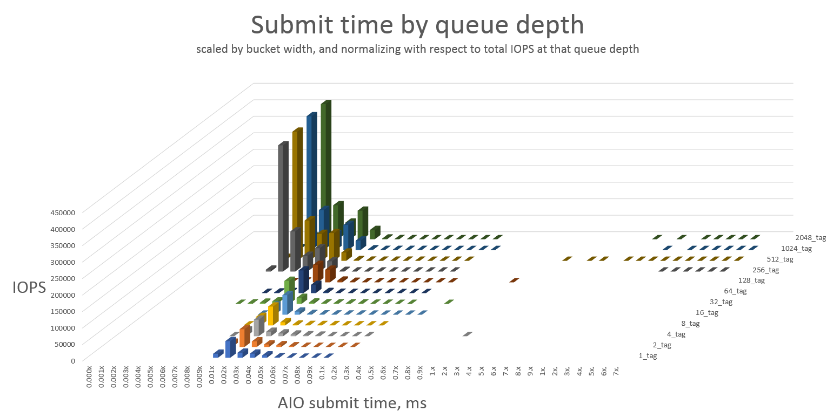
AIO “switches gears” with more AIO slots than OS tags
Most I/Os submit faster
More AIO slots than OS tags
Some outliers in physical I/O service time range
AIO slots 1:1 with OS tags

Slide 7
Making meaningful measurements
When AIO submit time is “fast”, ivy really is measuring how the device driver / HBA / subsystem performs at the specified queue depth (maxTags setting).
When AIO submit time is “slow”, the queue depth that ivy is generating is NOT the queue depth that is running on the device driver / HBA / storage subsystem.
I/Os are being queued in the OS, and a smaller queue depth is actually running on the storage.
For consideration:
We should think about if / when a test should be marked “invalid” because the queue depth generated by ivy is NOT reaching the storage. For some tests, this is OK. For other tests, for example, queue depth scalability tests, we may want to at least label points if not invalidate them when the ivy-driven queue depth does not reach the HBA/storage.

